Slide 1
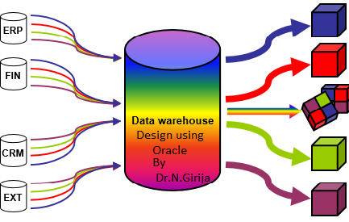
1.1 Fact table
OER UNIT 1 – SCHEMA DESIGN
PART 1 Fact table

Slide 2
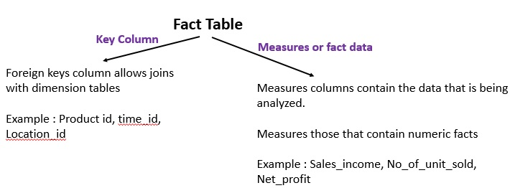
1.1 Fact table

Slide 3
OER UNIT 1 – SCHEMA DESIGN
PART 2 Dimension table

Slide 4
1.2 Dimension Table
Dimension is a collection of reference information about a measurable in the fact table.
The primary key column of the dimension table has uniquely identifies each dimension record or row.
The dimension tables are organized has descriptive attributes. For example, a customer dimension’s attributes could include first and last name, birth date, gender, Qualification, Address etc.,

Slide 5
OER UNIT 1 – SCHEMA DESIGN
PART 3 Star Schema

Slide 6
1.3 Star Schema
Star Schema a Multidimensional data representation of relational database schema
A star schema contains two types of tables – Fact table and dimension table.
A Fact table in the middle connected to a set of dimension tables
In a star schema, a dimension table will not have any parent table
Each dimension table have primary key that corresponds exactly to one of the components of the composite key in the fact table

Slide 7
steps of designing star schema
Identify the business process. i.e Fact table For example - sales, reservation
2. Identify the measures or fact data i.e in the sales fact table net_profit, sales_income, No_of _unit_sold.
3. Identify the Dimension table related to fact table. For example product, Time, Location, Branch
4. List of attributes or column in each dimension table
5. Find the lowest level of aggregation or summary analysis in the fact table. Ex. Total sales income.

Slide 8
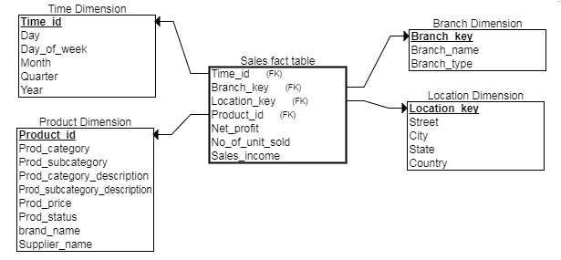

Slide 9
1.3.1 Snowflake Schema
Snowflake Schema is a refinement of star schema where some dimensional hierarchy is normalized into third normal form and forms a set of smaller dimension tables.
Snowflake schema keeps same fact table structure as star schema.
In the dimension, it has multiple levels with multiple hierarchies.
From each hierarchy of levels any one level can be attached to Fact Table.
Mostly lowest level hierarchy is attached to Fact Table. These hierarchies help to drill down the data from topmost hierarchies to the lowermost hierarchies.
Tables which describe the dimensions will already exist and will typically be normalized.

Slide 10
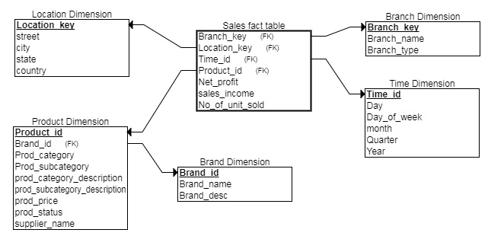

Slide 11
1.3.2. Galaxy schema or Fact cancellation schema
Multiple fact tables share dimension tables.
This schema is viewed as collection of stars hence called galaxy schema or fact constellation.
Sophisticated application requires such schema.
For Data warehouse the fact constellation schema is commonly used since it can model multiple, interrelated subjects.

Slide 12
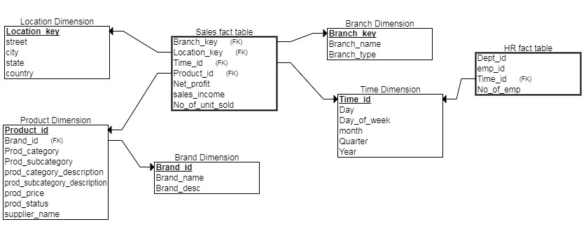

Slide 13
OER UNIT 1 – SCHEMA DESIGN
PART 4 CREATE DIMENSION statement

Slide 14
Before creating dimension, first create product table as a base table and then create dimension table product_dim.
conn hr/hr
Create table product( product_id number(5) primary key,prod_category varchar2(15),product_subcategory varchar2(15),prod_category_desc varchar2(20),Prod_subcate_desc varchar2(20),prod_price number(8,3),prod_status varchar2(5),brand_name varchar2(15),supplier_name varchar2(20));
The SQL CREATE DIMENSION statement supports the specification of levels, hierarchies and attributes.

Slide 15
CREATE DIMENSION
The SQL CREATE DIMENSION statement supports the specification of levels, hierarchies and attributes.
SYNTAX:
CREATE DIMENSION <DIMENSION_NAME>
LEVEL <LEVEL NAME> IS <TABLE_NAME.COLUMN NAME>
HIERARCHY <HIERARCHY NAME>
(<CHILD LEVEL_NAME> CHILD OF <PARENT LEVEL_NAME>)
ATTRIBUTE <LEVEL NAME> DETERMINES (<COLUMN NAME>)

Slide 16
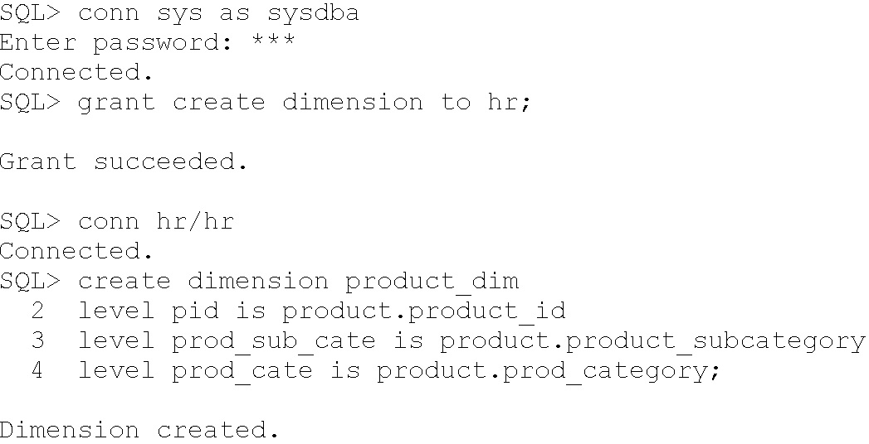
1.5 LEVEL
LEVEL is a first part of a Dimension declaration, which involves the specification of levels.
All Dimension names are unique in the database, dimension is a database object like table, index, view etc.,
If product_dim is already exist then for adding or modifying level use ALTER dimension otherwise drop dimension product_dim again re-create CREATE DIMENSION product_dim
Most dimensions involve multiple levels, in the example there are three Levels namely pid, prod_sub_cate, prod_cate
Suppose HR user don't privilege have to create dimension, then grant create dimension privilege to Hr user then create dimension.

Slide 17
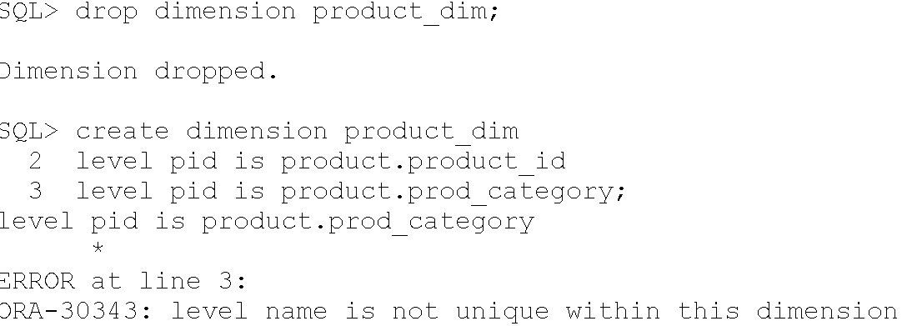
1.5.1 Identical Level name
All the level name in the dimension to be unique not identical. If both the level has the same level name. So, it gives error message.

Slide 18
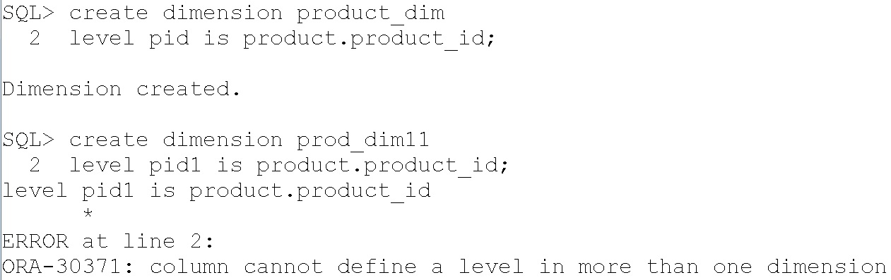
1.5.2. Don't repeat the same column as level in different dimension
Using same column not allow to create as level even though the dimension is different and level name is different.
Therefore only one time the column name of the table is allowed to create dimension.
Duplicating the column for level and dimension is not allowed.

Slide 19
1.6 Hierarchies
Hierarchies are used for data aggregation in data warehousing, it is logical structures that use ordered levels of organizing data.
Example, time dimension, a hierarchy might aggregate data from the month level to the quarter level to the year level.
Using hierarchies to drill down into data in the data warehousing to view different levels of granularity.
For example, city is a child of state (because you can aggregate city-level data up to state).
A hierarchical relationship is a functional dependency from one level of a hierarchy to the next level in the hierarchy, the CHILD OF relationship denotes that each child's level value is associated with one and only one parent level value
If the columns of a parent level and child level are in different relations, then the connection between them also requires a 1:n join relationship
Column of each hierarchy level are non-null that hierarchical integrity should be maintained.
Hierarchy level cannot be joined to itself either directly or indirectly.

Slide 20
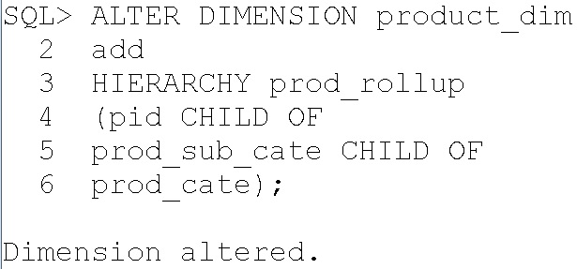
A single dimension definition can contain multiple hierarchies.
Non-hierarchical dimension are referred as “Flat Dimension”, there is only a single level in a dimension
Here, we already created product_dim, so ALTER dimension add hierarchy or otherwise drop dimension product_dim and re-create product_dim again.

Slide 21
1.6.1. Hierarchy Using Join key
Join key is used in snowflakes schema for joining parent dimension and child dimension.
Hierarchy level cannot be joined to itself either directly or indirectly.
step 1: drop the brand_name from product table because it is normalized into another dimension called brand table
alter table product drop column brand_name;
step 2: Normalize the product table and create new table brand with three column
create table brand(brand_id number(5) primary key, brand_name varchar2(15),brand_desc varchar2(20));
Step 3: Alter the table product and create foreign key relationship between product and brand table.
alter table product add brand_id number(5) references brand(brand_id);
step 4: create level for brand table primary key

Slide 22
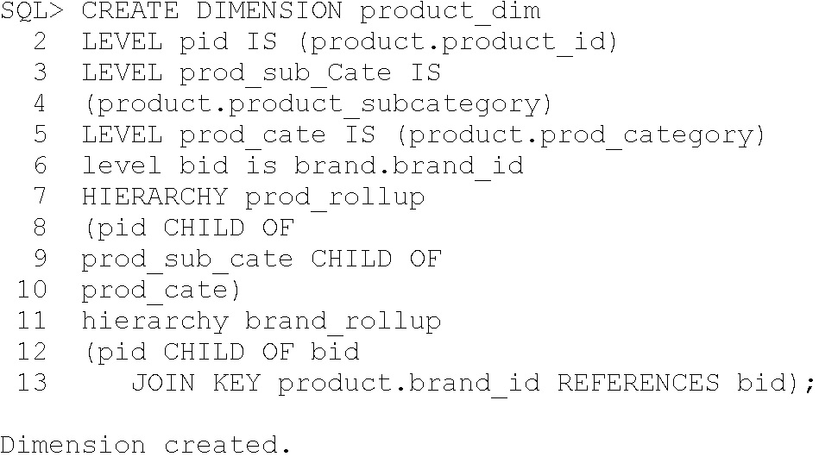
step 5: create hierarchy brand_rollup using join key with product brand_id and brand.brand_id

Slide 23
1.7 Attributes
The ATTRIBUTE clause defines functional dependency relationships involving dimension levels and non source columns in dimension tables.
The attribute_clause specify the columns that are uniquely determined by a hierarchy level. There must be a 1:1 attribute relationship between hierarchy levels and their dependent dimension attributes
The dependent_columns need not have been specified in the level_clause. For example prod_status is not specified in the level name.
ALTER DIMENSION PRODUCT_DIM ADD
ATTRIBUTE PID DETERMINES PROD_STATUS;
OR
ATTRIBUTE PID DETERMINES PRODUCT.PROD_STATUS;
The columns in level must all come from the same table as the dependent_columns.
ALTER DIMENSION PRODUCT_DIM ADD
ATTRIBUTE PID DETERMINES BRAND.BRAND_DESC;
because level pid from product table but attributes brand_desc from brand table.

Slide 24
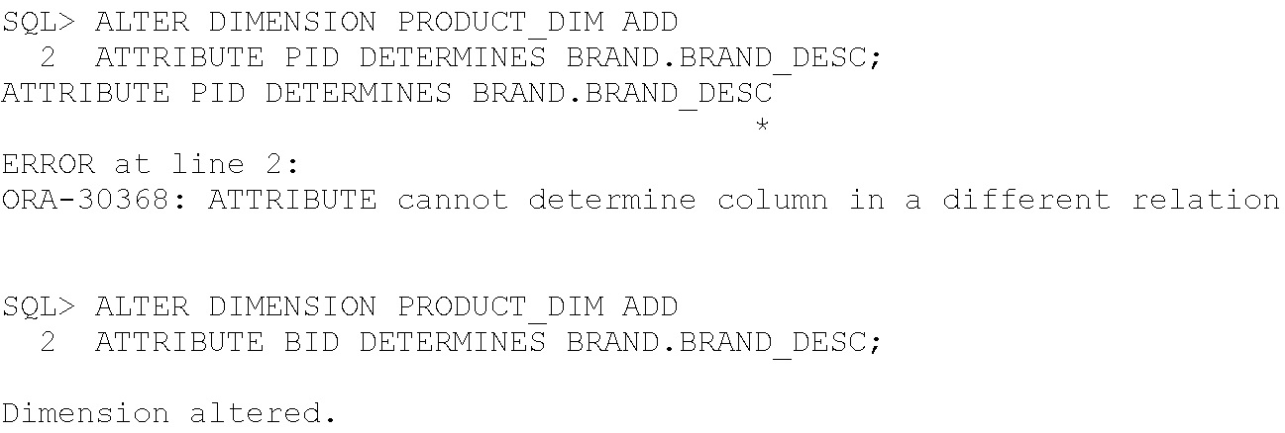
1.7.1 Extended_attribute_clause
The only difference is that this clause assigns a name to the attribute that is different from the level name.
If the extended_attribute_clause is used to create multiple columns determined by a hierarchy level.
ALTER DIMENSION PRODUCT_DIM
ADD
ATTRIBUTE SUPP LEVEL PID DETERMINES SUPPLIER_NAME;
In the above example SUPP is attribute name.

Slide 25
1.8 ALTER DIMENSION
If dimension is already exist then using alter dimension statement it is easy to include hierarchy or level or attributes into the dimension.
In the same manner removing or modifying the level, hierarchy or attribute also possible using alter dimension...drop statement.
1.8.1 Alter Dimension using ADD
Add level
ALTER DIMENSION PRODUCT_DIM
ADD
LEVEL PPRICE IS PRODUCT.PROD_PRICE;
Add Hierarchy
ALTER DIMENSION PRODUCT_DIM
ADD
HIERARCHY PRICE_ROLLUP
(PID CHILD OF PROD_CATE CHILD OF PPRICE);
Add Attribute
ALTER DIMENSION PRODUCT_DIM
ADD
ATTRIBUTE psubcate level pid DETERMINES
(product.product_subcategory, Prod_subcate_desc);

Slide 26
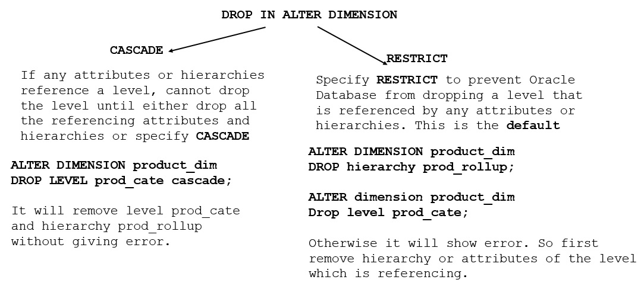
1.8.2 Alter Dimension using DROP
CASCADE and RESTRICT is used for restricting DROP IN ALTER DIMENSION.

Slide 27
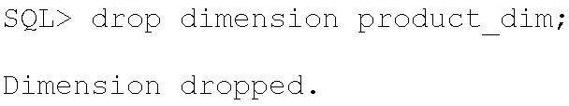
you can drop one attribute column without dropping them all.
The following statement illustrates how you can drop a single column without dropping all columns:
ALTER DIMENSION product_dim
DROP ATTRIBUTE psubcate LEVEL pid COLUMN Prod_subcate_desc;
1.9. DROP Dimension
A dimension is removed using the DROP DIMENSION statement. For example:

Slide 28
1.1 Fact table
OER UNIT 1 – SCHEMA DESIGN
PART 5 Display Dimension

Slide 29
In the database schema, the dimension is one of the objects like table, index.
select object_type, object_name FROM user_objects
where object_type='DIMENSION';
‘DIMENSION’SHOULD BE IN CAPITAL LETTER
SQL> SET LINESIZE 400;
SQL> select object_type,object_name FROM user_objects where object_type='DIMENSION';
OBJECT_TYPE OBJECT_NAME
------------------- -----------------------------------------
DIMENSION PRODUCT_DIM

Slide 30
1.1 Fact table
OER UNIT 1 – SCHEMA DESIGN
PART 6 Dimension Status

Slide 31
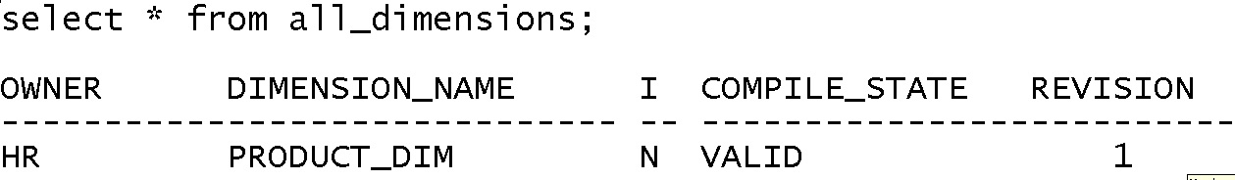
1.11 Dimension status
“All_dimensions” gives the number of dimension created by the user and also tells the status of each dimension table whether it is, ERROR, NEEDS_COMPILE, VALID etc.
Select * from all_dimensions;

Slide 32
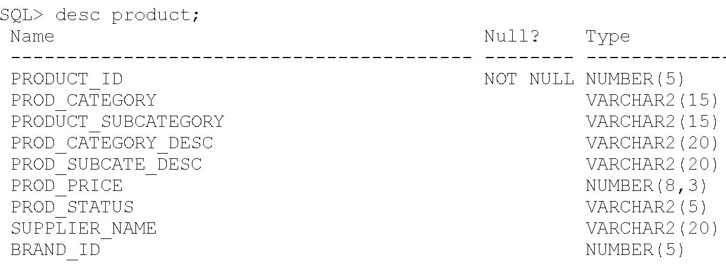
1.13.2 Revalidate Dimension status
Suppose after creating the dimension for product table called “product_dim”, alter the structure of the base table any column data type or size of the column.

Slide 33
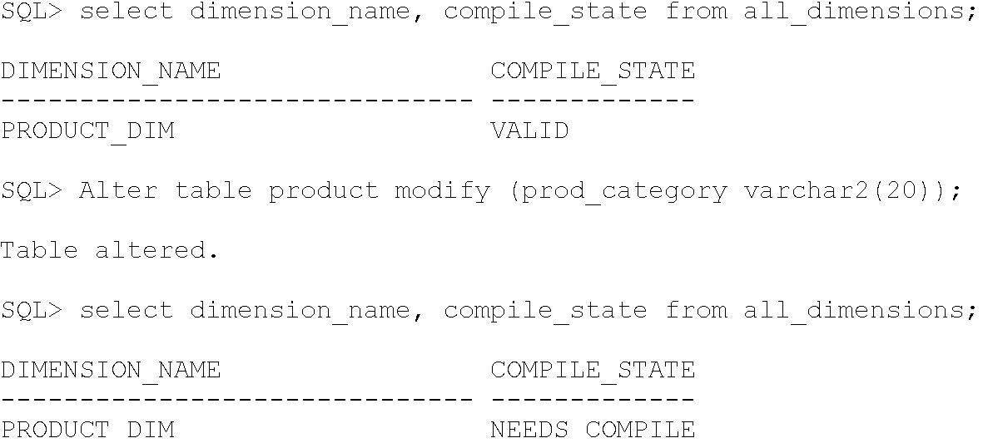
Modify the prod_category varchar2(15) into prod_category varchar2(20);
select dimension_name, compile_state from all_dimensions;
Alter table product modify (prod_category varchar2(20));

Slide 34
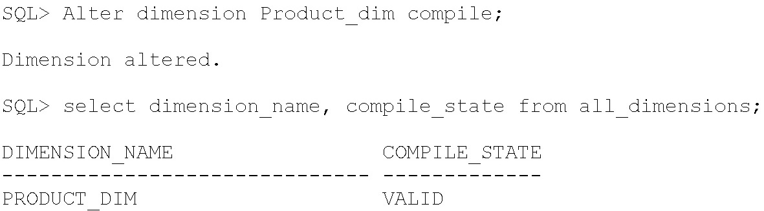
To revalidate the dimension “product_dim”, use the COMPILE option; now check the status of dimension again, the status has changed as “VALID”
Alter dimension Product_dim compile;
select dimension_name, compile_state from all_dimensions;

Slide 35
1.1 Fact table
OER UNIT 1 – SCHEMA DESIGN
PART 7 Retrieve Dimension

Slide 36
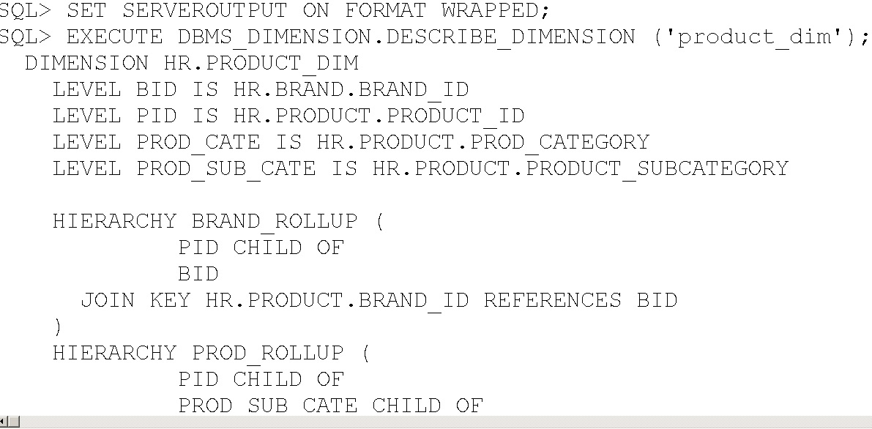
1.12 Retrieve Dimension
To view the definition of a dimension, use the DESCRIBE_DIMENSION procedure in the DBMS_DIMENSION package.
it will display how many level, hierarchy and attributes are available within the dimension.

Slide 37
1.1 Fact table
OER UNIT 1 – SCHEMA DESIGN
PART 8 Validate Dimension

Slide 38
1.13 Validate Dimension
For verifying the validity of the relationship specified in the dimensions use DBMS_DIMENSION.VALIDATE_DIMENSION procedure periodically.
This procedure is easy to use and has only four parameters:
* Dimension: who created the dimension or owner of the dimension object
* Incremental: set to TRUE to check only the new rows for tables of this dimension.
* Check nulls: set to TRUE to verify that all columns that are not in the levels containing a SKIP WHEN NULL clauses are not null.
* Statement_id: user-supplied unique identifiers to identify the result of each run of the procedure
In this example
dimension='hr.product_dim', incremental = FALSE, check_nulls=TRUE, statement_id='error catch'

Slide 39
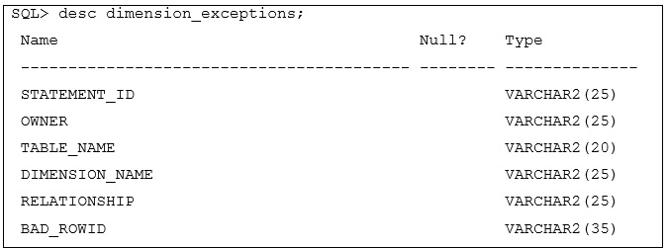
1.13.1 Dimension_Exceptions
Before running the VALIDATE_DIMENSION procedure, need to create a local table, DIMENSION_EXCEPTIONS.
If the VALIDATE_DIMENSION procedure encounters any errors, the errors are stored in DIMENSION_EXCEPTIONS table.
Querying this table will identify the exceptions that were found.

Slide 40
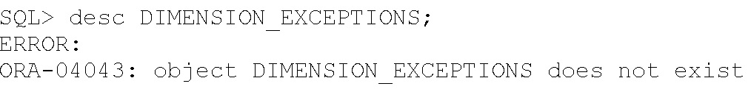
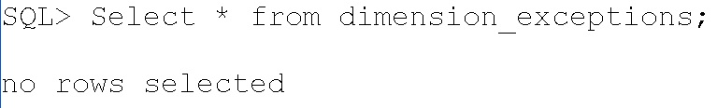
Step 1: check whether dimension_exception table is exit or not, then it will be created only once.
Step 2: suppose it is not exist, then create the dimension_exceptions table.
create table dimension_exceptions(STATEMENT_ID VARCHAR2(25),OWNER VARCHAR2(25),TABLE_NAME VARCHAR2(20), DIMENSION_NAME VARCHAR2(25), RELATIONSHIP VARCHAR2(25),BAD_ROWID VARCHAR2(35));
Step 3: Execute the validate_dimension procedure
EXECUTE DBMS_DIMENSION.VALIDATE_DIMENSION('hr.product_dim',FALSE, TRUE,'error catch');
Step 4: check there is any error in the dimension exception stored
At present, there is no error occurred in the dimension_exceptions table.

Slide 41
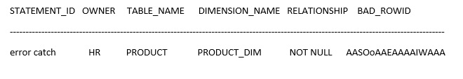
Step 5: check with errors
Try to insert two records in the base table store.
SQL> Insert into product(PRODUCT_ID,PROD_CATEGORY) values (11,'Electronics');
1 row created.
SQL> insert into product (PRODUCT_ID,PROD_CATEGORY) values(11,'Cosmetics');
insert into product (PRODUCT_ID,PROD_CATEGORY) values(11,'Cosmetics')
*
ERROR at line 1:
ORA-00001: unique constraint (HR.SYS_C0011199) violated
Select * from dimension_exceptions;

